Slide 1




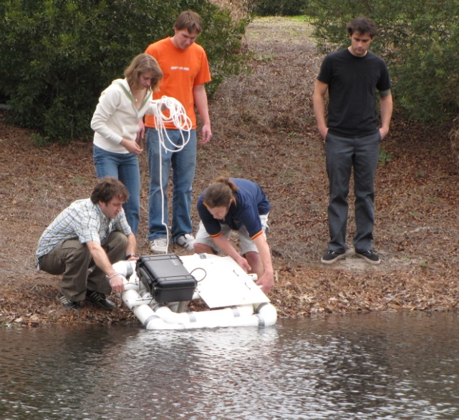
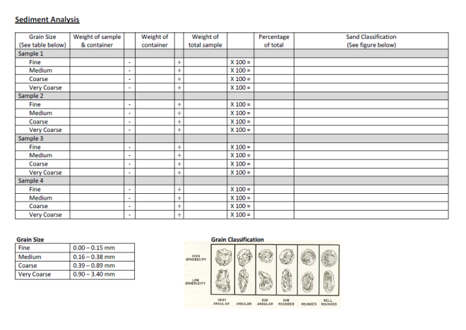
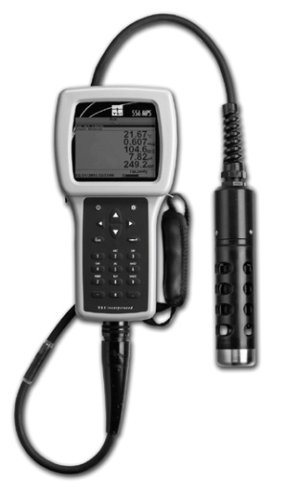
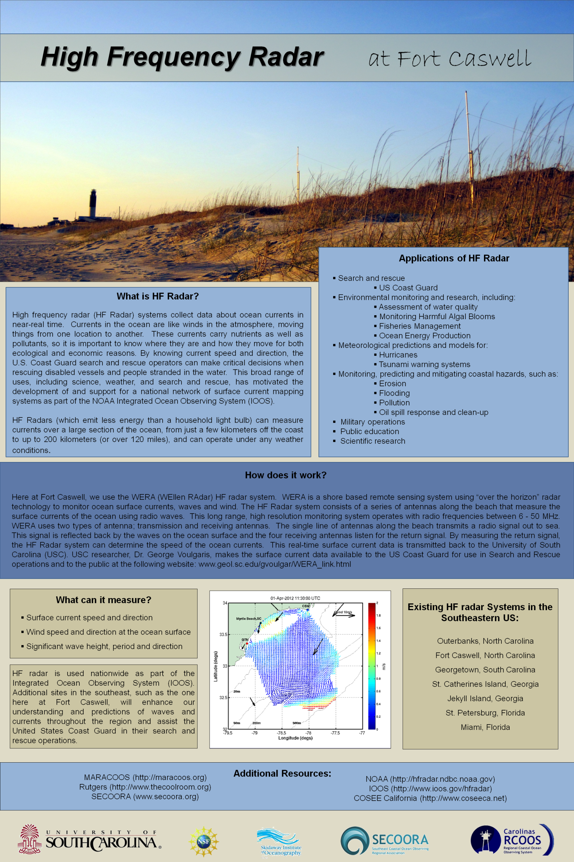
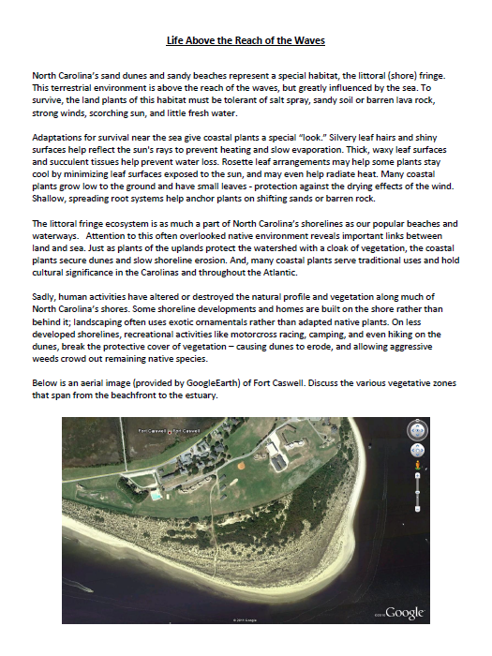
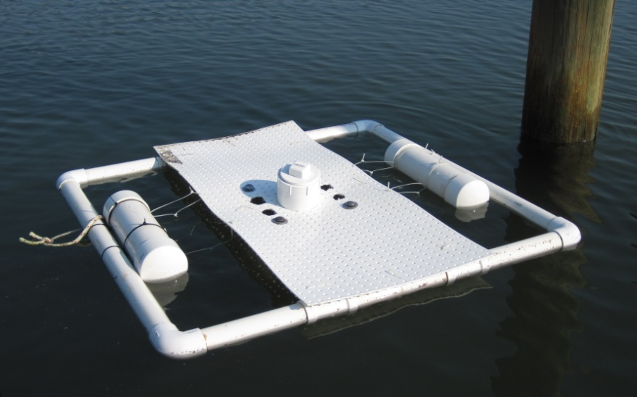
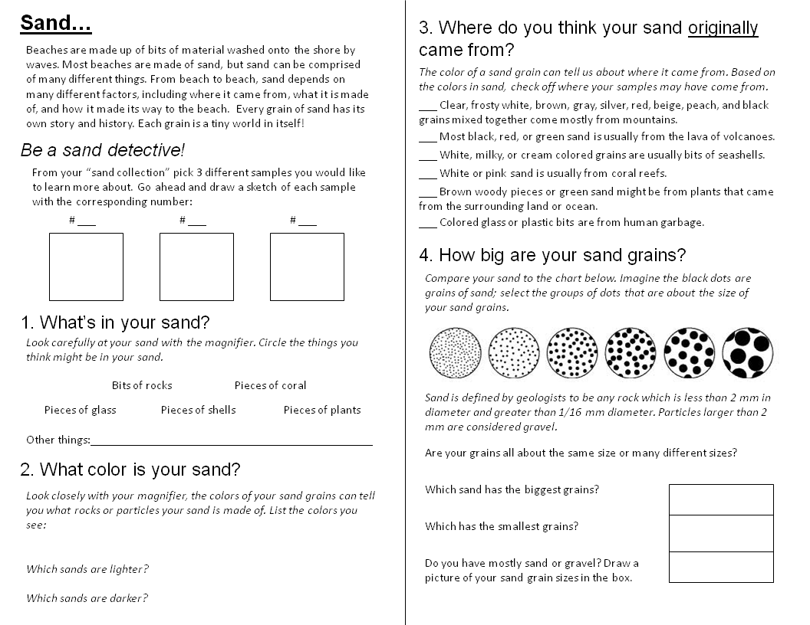
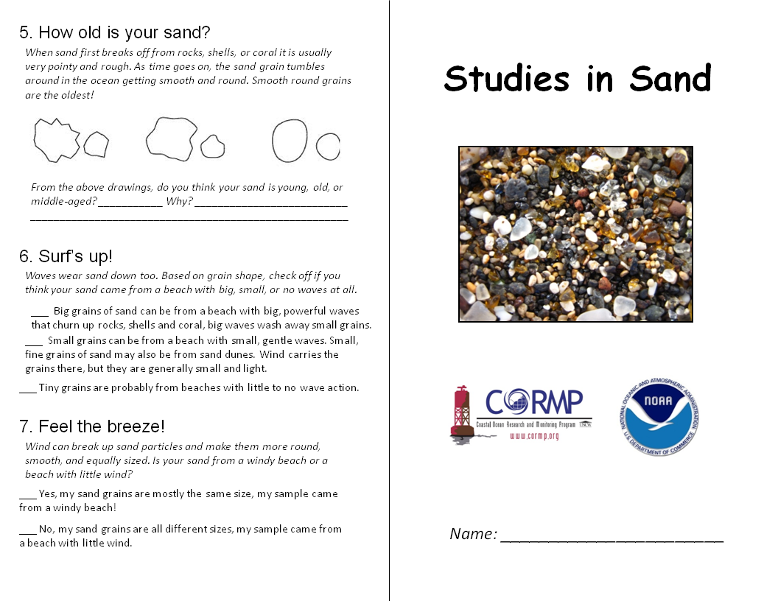
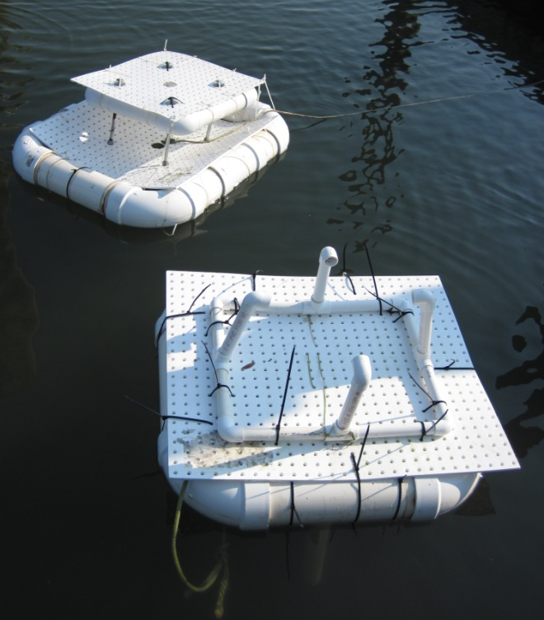
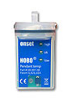

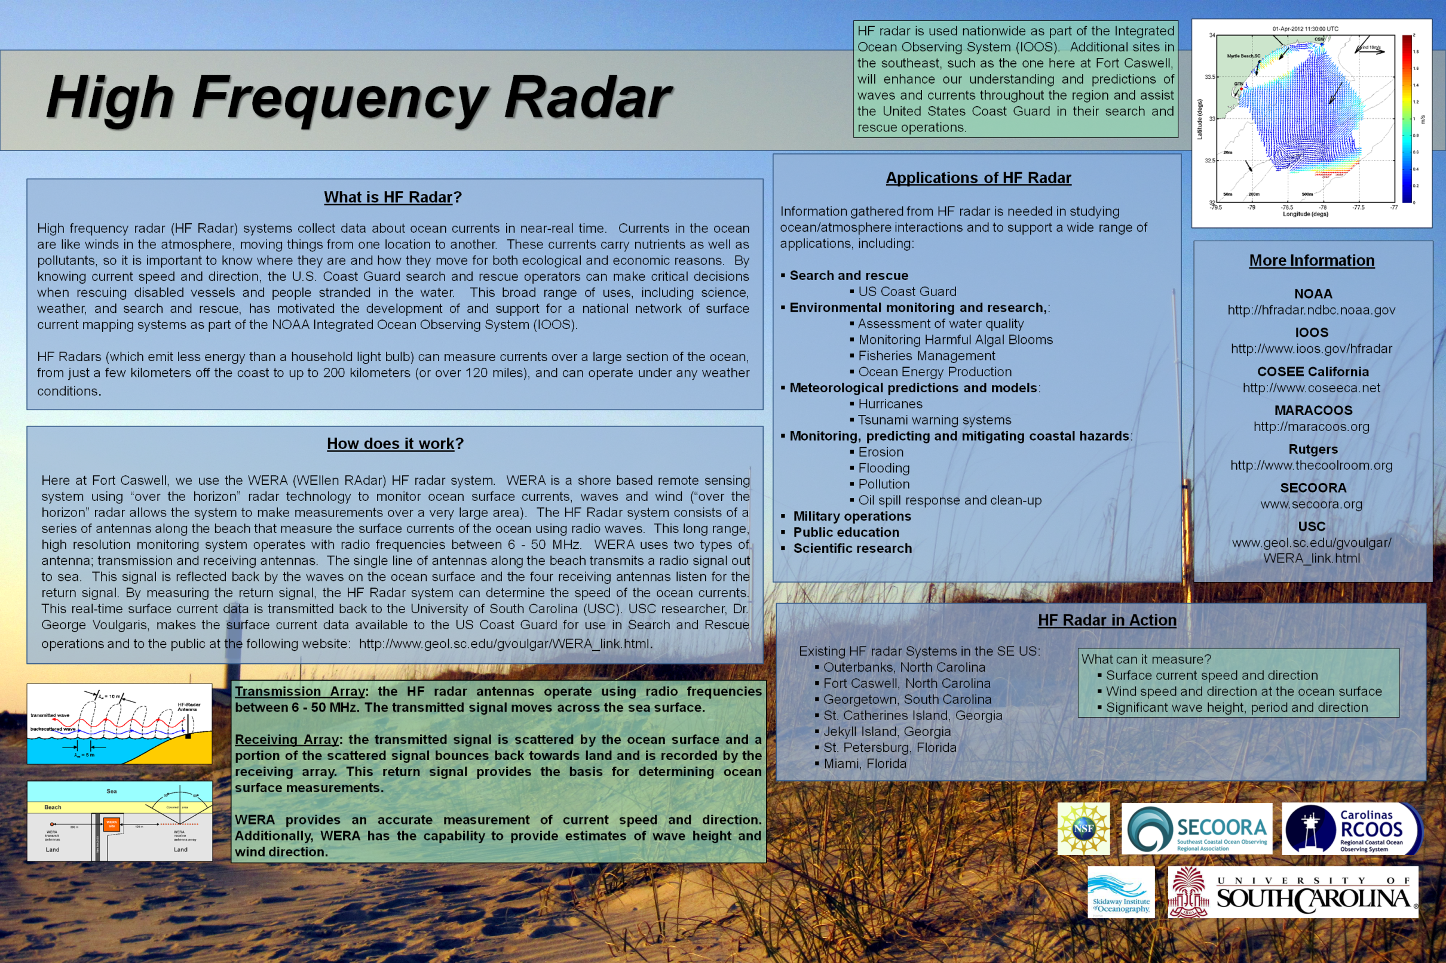
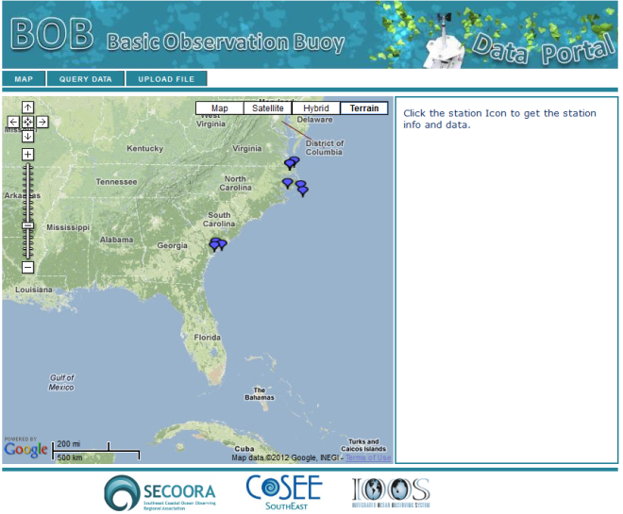
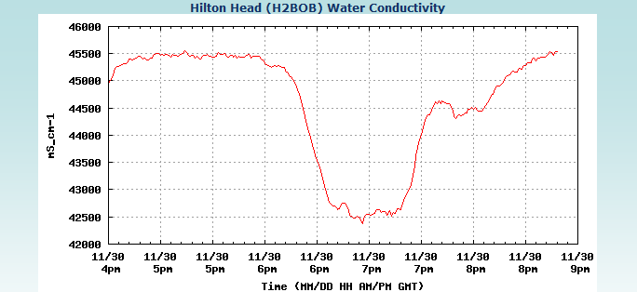
Outreach and Education Efforts at UNCW
Lynn Leonard , Jennifer Dorton, and Kerri Allen
Basic Observational Buoy
Climate Change Monitoring Program
High Frequency Radar
Formal Education
Coastal Ocean Methods
Geology 480/592
12 students (graduate and undergraduate)
YSI Sensors
Deployed buoy in freshwater (campus pond)
and salt water (dock at CMS)
Coastal Ocean Observing
Geology 480
20 students (undergraduate)
SeaBird CTD, HOBO CT loggers
Several buoys, different designs
Deployed in test tank, dock at the UNCW Center Marine Science
Personnel
UNCW Professors & Educators
Buoy Specialist Jeff Kinder, DownEast Instrumentation
Carolinas RCOOS Personnel (Instrument Specialists)
Curriculum Development
Graduate and Undergraduate curriculum
Carolinas RCOOS K-12 Climate Change Monitoring Program curriculum
Share with SECOORA as well as educators in NC
K-12 Curriculum
Extensive climate-change based marine science education has been shared with educators, including the environmental education program at the NC Baptist Assembly at Fort Caswell.
Question
“How can students and volunteers track climate changes in the nearshore coastal environment?”
Approach
Break “Climate Change” concept into three tangible, identifiable units:
Sand, Water Quality, Shoreline Dynamics
Outreach Materials
K-12 lessons for the environmental education program at the NC Baptist Assembly at Fort Caswell were developed to coincide with the recent USC installation of an HF Radar system.
Posters for public display were also created to help educate both visitors and locals about the HF Radar antennas on Caswell Beach. The HF Radar data is available to the public at the following website: www.geol.sc.edu/gvoulgar/WERA_link.html
Ocean Acidification
Where in the World?
Students take a closer look at individual sand grains under a microscope
Surf’s Up!
Examines grain shape and angularity in connection to wave and current activity
Shifting Sands
Students examine effects of wind on sorting; Introduction to grain size and sieving
Physical Attraction
Match photos to sand samples, looking at physical & environmental factors influencing sand formation
Sand Slides
Students examine magnetic sands and take a closer look at composition
Effects of ocean acidification on calcareous material
Sand Detective
Using “sand boxes” students take a closer look at the history of their samples
Sand Unit
Abiotic and Biotic Sands
Sources of sand
Carbonate Production
Sediment Budget
Bioerosion
Sand Composition
Informal Education
Summer Ventures
Coastal Geography Course, 2009
14 students, rising juniors and seniors from NC high schools
Deployed in freshwater (Cape Fear River) and salt water (tidal creeks)
YSI (pH, dissolved O₂, conductivity, temperature)
Water samples for other chemical studies
MarineQuest
TechnOceans Camp
Ages 14-17
40 students (2011)
Reusable BOB’s
Deployed for 36-48 hours
Silicone and duck tape
1/3 of cost and reduced waste
Deployed at the UNCW Center for Marine Science
PASCO GLX (pH, DO, temperature, conductivity)
Blue Planet
World ocean covers over 70% of Earth’s surface; importance of water quality
Watershed Development
Delineating Watersheds; role of non-point source pollution on water bodies
Water Quality
Test Kits
Salinity, temperature, turbidity, dissolved oxygen, nitrates, phosphates, pH
Water Quality Indicators
Vocabulary and discussion of each parameter
What Can YOU Do?
Easy steps to improve water quality in your community (games, worksheets, etc.)
Water Quality Unit
Clean Water Act
Water Quality Standards
Water Quality Parameters
Natural and Anthropogenic
Factors influencing water quality
Non-point vs Point Source Pollution
Harmful Algal Blooms
Impact on Marine Life
BOB Web Portal
Beach Profiling
Graphing Beach Profile
Visual method of observing beach movement
Fringe Ecosystem
Dune Vegetation; Coastal Plant/Animal Adaptations
Field Mapping
Explorer’s Field Book
Scientific Method
Nearshore Currents
Understand processes shaping and influencing beachface; Measure longshore drift
Modeling Beach Erosion
Impact of hard structures on beachface
“Roxy’s Rough Ride to the Beach”
Beach formation
Factors that affect sediment transport
History/travel of sand grains to beachface
Link: http://cormp2.das.uncw.edu/dev/
The BOB portal allows BOB users (e.g. students and educators) to upload and share their observational buoy data with the broader BOB community. BOB users upload data files to a centralized database and have the ability to query and graph data.
BOB portal development has been led by SECOORA, UNCW, COSEE-SE, and Kennesaw State University.
Shoreline Dynamics Unit
History of sand grains
Dynamic Equilibrium
Coastal Erosion
Zonation
Presence and impact of
hard structures
Funding Provided by: SECOORA NA11NOS0120033
Acknowledgements: COSEE, George Voulgaris (USC), NC Baptist Assembly at Fort Caswell

