Slide 1
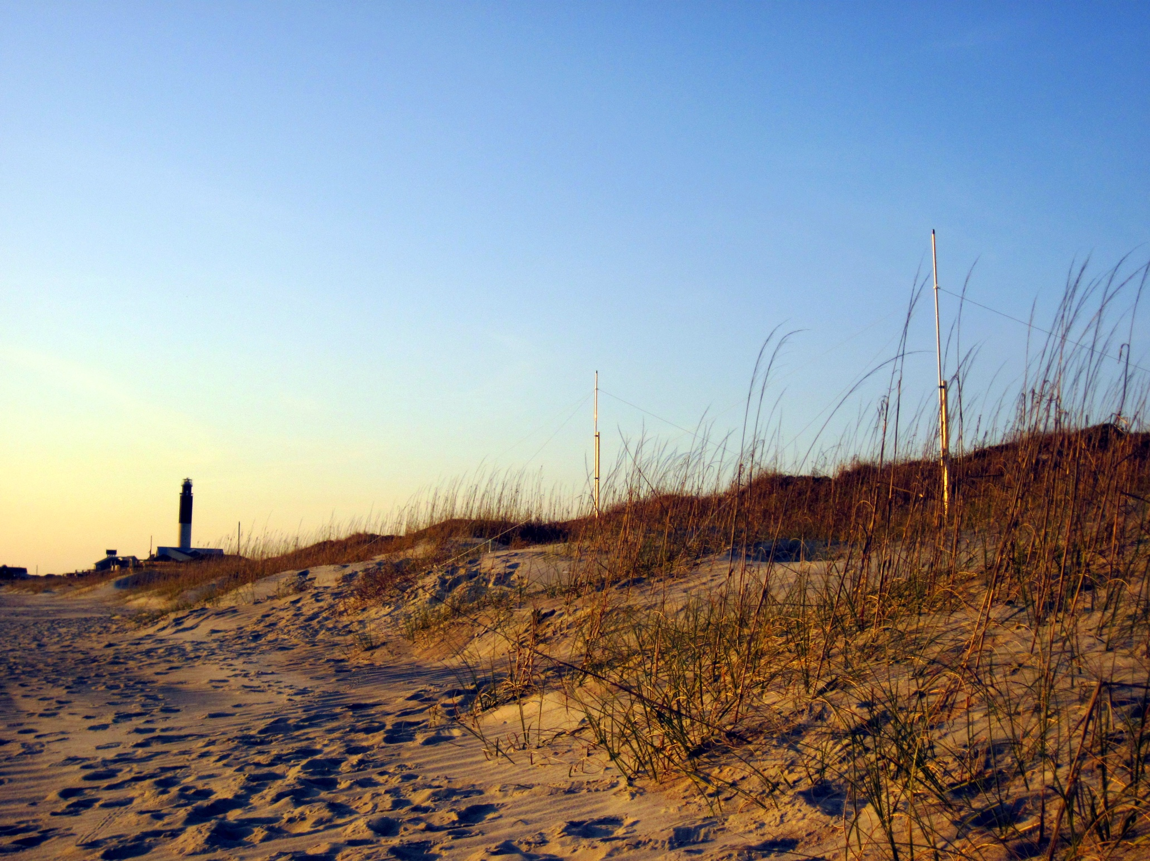
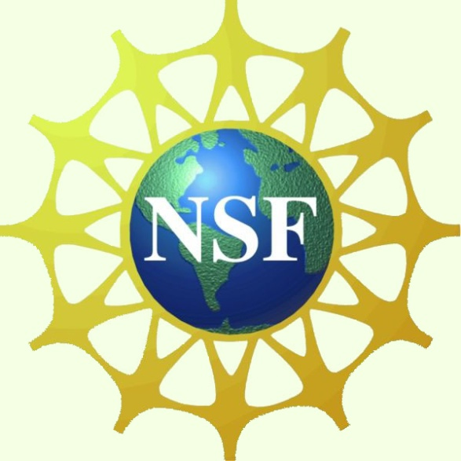
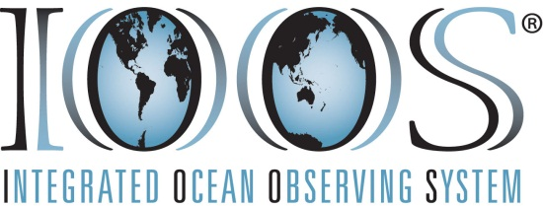
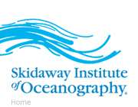
High Frequency Radar at Fort Caswell
Applications of HF Radar
Search and rescue
US Coast Guard
Environmental monitoring and research, including:
Assessment of water quality
Monitoring Harmful Algal Blooms
Fisheries Management
Ocean Energy Production
Meteorological predictions and models for:
Hurricanes
Tsunami warning systems
Monitoring, predicting and mitigating coastal hazards, such as:
Erosion
Flooding
Pollution
Oil spills
Military operations
Public education
Scientific research
What is HF Radar?
High Frequency Radar (HF Radar) systems collect ocean current data in near real-time. Currents in the ocean are like winds in the atmosphere, moving things from one location to another. These currents carry nutrients as well as pollutants, so it is important to know where they are and how they move for both ecological and economic reasons. By knowing current speed and direction, the U.S. Coast Guard Search and Rescue operators can make critical decisions when rescuing disabled vessels and people stranded in the water. This broad range of uses, including science, weather, and search and rescue, has motivated the development of and support for a national network of surface current mapping systems as part of the NOAA Integrated Ocean Observing System (IOOS).
How does it work?
Here at Fort Caswell, we use the WERA (WEllen RAdar) HF radar system. WERA is a shore based remote sensing system using “over the horizon” radar technology to monitor ocean surface currents, waves and wind. The HF Radar system consists of a series of antennas along the beach that measure the surface currents of the ocean using radio waves. This long range, high resolution monitoring system operates with radio frequencies between 6 - 50 MHz. WERA uses two types of antenna; transmission and receiving antennas. The single line of antennas along the beach transmits a radio signal out to sea. This signal is reflected back by the waves on the ocean surface and the four receiving antennas listen for the return signal. By measuring the return signal, the HF Radar system can determine the speed of the ocean currents. This real-time surface current data is transmitted back to the University of South Carolina (USC). USC researcher, Dr. George Voulgaris, makes the surface current data available to the National Oceanographic and Atmospheric Administration (NOAA), who in turn provide the data to the US Coast Guard for use in Search and Rescue operations as well as to the public. You can access HF Radar data at the following website: www.geol.sc.edu/gvoulgar/WERA_link.html.
What can it measure?
Surface current speed and direction
Wind speed and direction at the ocean surface
Significant wave height, period and direction
Existing HF radar Systems in the Southeastern US:
Outer Banks, North Carolina
Fort Caswell, North Carolina
Georgetown, South Carolina
St. Catherines Island, Georgia
Jekyll Island, Georgia
St. Petersburg, Florida
Miami, Florida
HF Radar is used nationwide as part of the NOAA Integrated Ocean Observing System (IOOS). Additional sites in the southeast, such as the one here at Fort Caswell, will enhance our understanding and predictions of waves and currents throughout the region and assist the United States Coast Guard in their search and rescue operations.
Additional Resources:
MARACOOS (http://maracoos.org)
Rutgers (http://www.thecoolroom.org)
SECOORA (www.secoora.org)
NOAA (http://hfradar.ndbc.noaa.gov)
IOOS (http://www.ioos.gov/hfradar)
COSEE California (http://www.coseeca.net)

